Slide 1
Quantitative Trading Strategy: Relative β-Strength and Market Regime Detection
Presented By: Or Dadush, Ophir Raphael, Shir Mesica

Slide 2
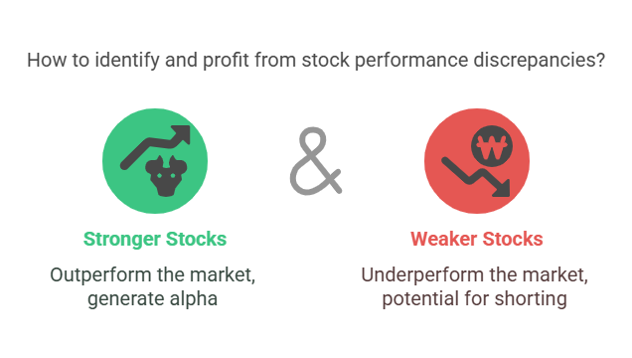
Introduction to the Strategy
Project Goal: To identify stocks that consistently outperform (stronger) or underperform (weaker) the overall market, and to profit from these relative performance discrepancies.

Slide 3
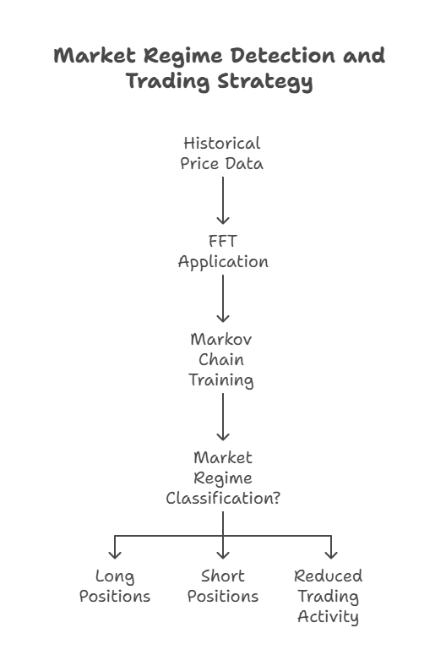
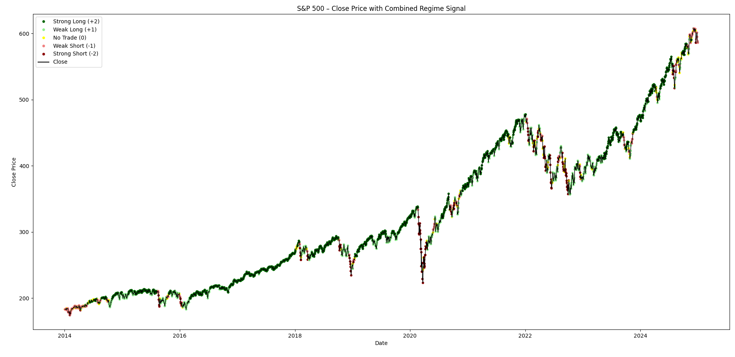
Market Regime Detection
Regime Modeling: The market regime is modeled using a combination of Fast Fourier Transform (FFT) and Markov chains.

Slide 4
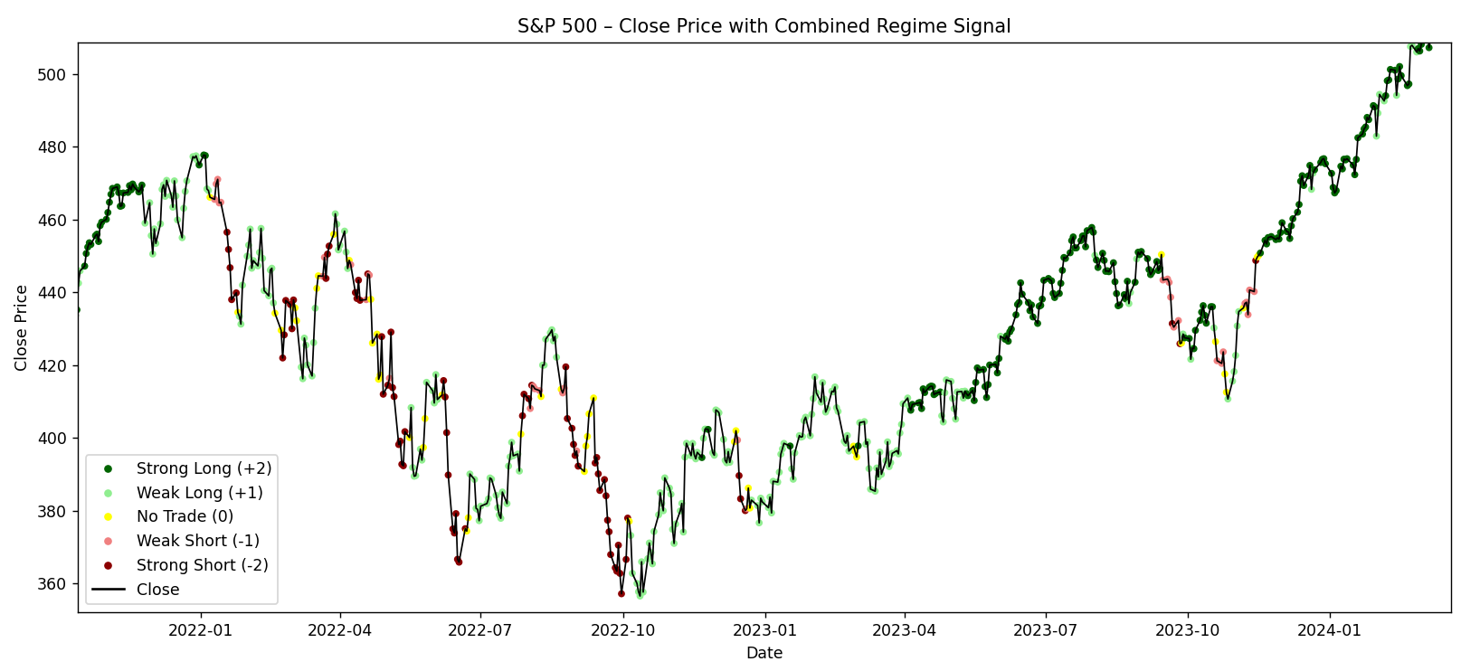
Inside Look

Slide 5
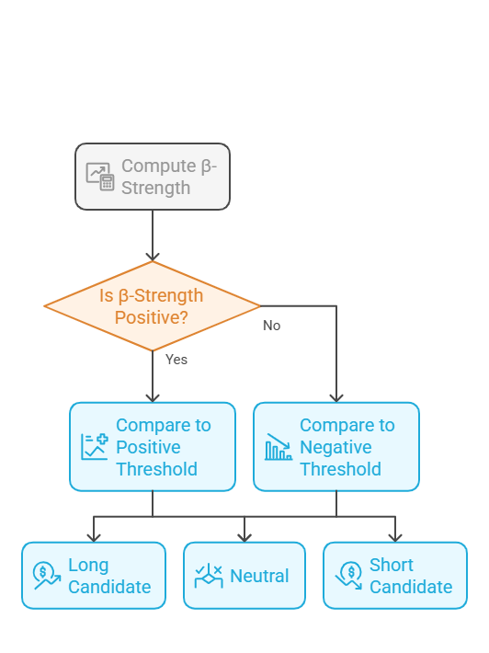
β-Strength Computation
score = days_up *(sum_stock_up - sum_market_up) - days_down * (sum_market_down - sum_stock_down)

Slide 6
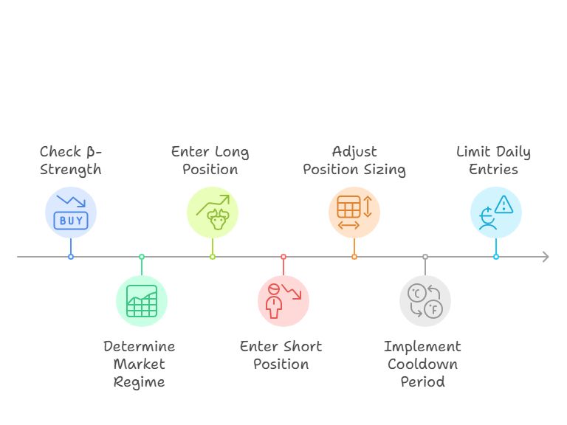
Quantitative Trading Strategy Sequence

Slide 7
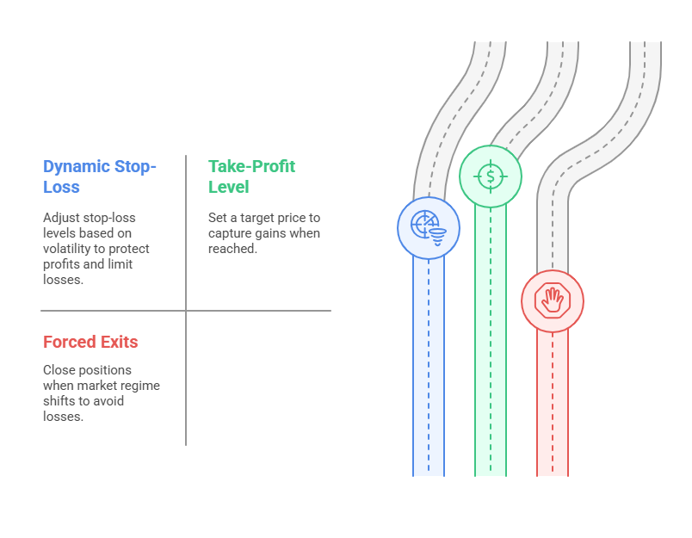
Positions Managing

Slide 8
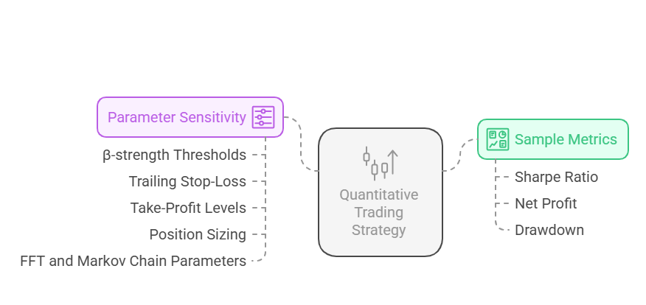
Trading Strategy: Metrics and Parameter Sensitivity

Slide 9
Results Till Now
Period | Total Trades | Win-Rate | Net P&L ($) | Max DD % | Sharpe Ratio
2014-2018 | 482 | 54.8 % | +15233 | 5.68 % | 2.20
2019 | 18 | 50.0 % | -834 | 0.98 % | 1.16
2020 | 465 | 42.6 % | -41704 | 47.22 % | 1.91
2021 | 30 | 53.3 % | +456 | 0.69 % | 0.64
2022 | 238 | 55.0 % | +3672 | 0.95 % | 1.28
2023 | 94 | 52.1 % | -227 | 3.45 % | -0.95
2024 | 234 | 54.7 % | +8603 | 7.63 % | 1.04
2019-2024 | 1430 | 49.9 % | -29758 | 35.56 % | 0.45

Slide 10
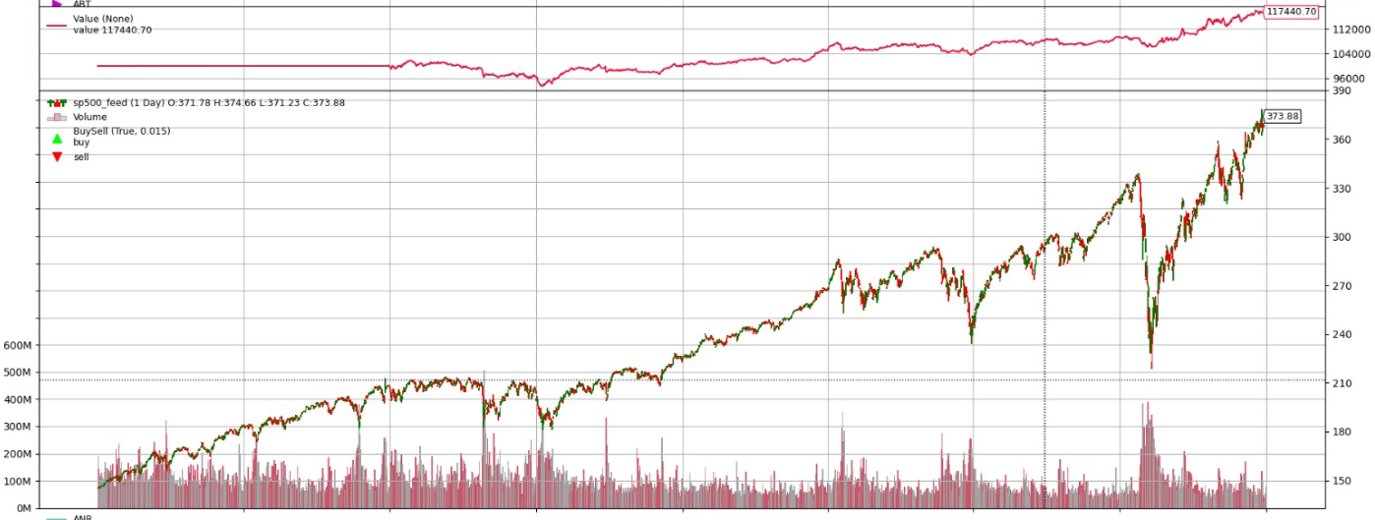
Portfolio hedging

Slide 11
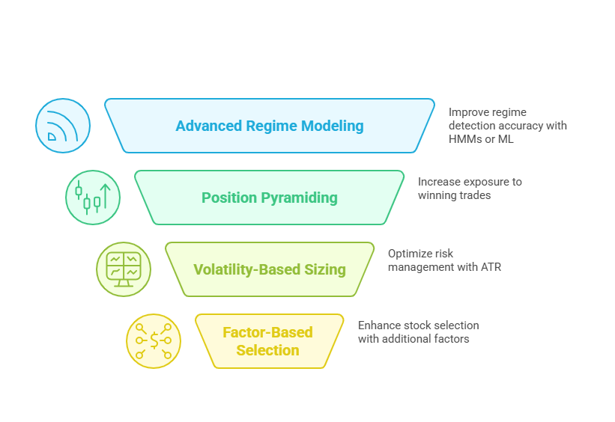
Enhancing Trading Strategy

